Slide 1
New Carrollton Green Infrastructure Database
By: Shreeya Pinumalla, Daniel Martins, Feras Ismail, and Hunter Horst

Slide 2




Our Team
Shreeya Pinumalla
Project Manager
Daniel Martins
Database Designer
Feras Ismail
StoryMaps Designer
Hunter Horst
Research & ArcGIS
Notes:
Could add pictures of each team member and/or elaborate on roles

Slide 3
Agenda
Intro/Problem
Scope Changes
Challenges
Deliverables
Future Recommendations

Slide 4

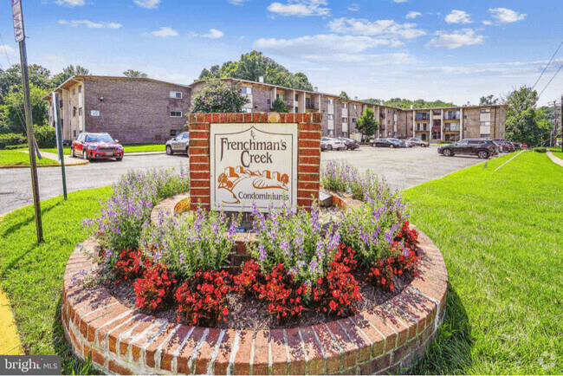

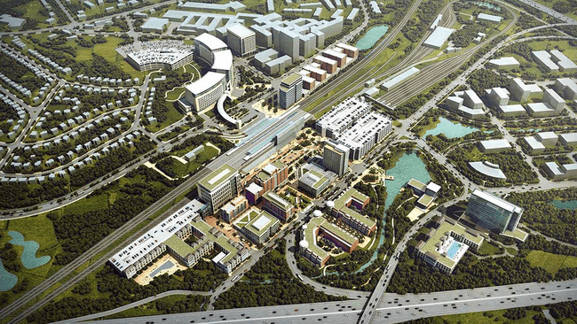
Intro

Slide 5
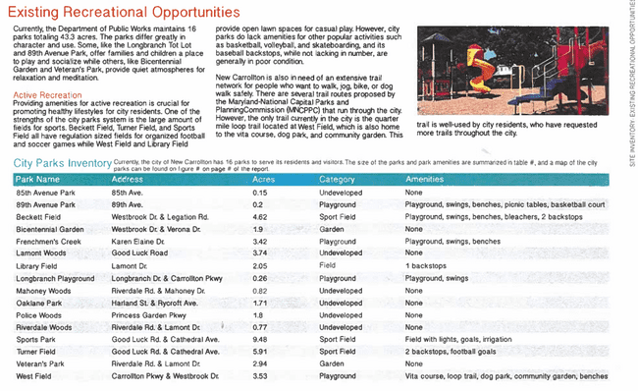
The Problem & Scope Change
NC lacks a parks & planning dept
Previous efforts by the City (NC Master Plan) resulted in excellent plans & ideas, but no way to execute them
So, our job was to research available data, organize it, and visualize it, so the City could begin work and tell residents about it

Slide 6
Post-Interview Requirements
A new focus on visualizations, both public-facing and internal
Less weight on the database itself, more on what we do with it
Finding new data still critical
PGC Parks & Planning has plenty of GIS data, but NC lacks the time to investigate
End goal: provide the City with the data they need to carry out their plans, and visualize it for public viewing

Slide 7
Challenging Events and Our Response
A lack of initial data
Hard to start on the project
Our research would benefit our client even more – providing data AND working with it
The “New Carrollton City Park Revitalization Master Plan”
Provided basic data, helpful details, reference material, and inspiration
Challenging to step outside its shadow and build on something so comprehensive
We incorporated ArcGIS late into the project
Our database and its visualizations do not use the ArcGIS data
We had a chance to learn from other aspects of the project
Inexperience with StoryMaps, ArcGIS
Challenging to work with new tools
We had a chance to learn & develop new, important skills
Not all parks belonged to New Carrollton
Ownership of some green spaces unclear, others are no longer owned by the City
Notes:
Split this into multiple slides WITH PICTURES

Slide 8
Deliverables
Database
Visualizations
StoryMaps (including pictures)
New ArcGIS and park ownership data
ArcGIS visualizations & analysis
Notes:
So we have a few deliverables we would like to share with you and our client. We created a database on excel with all the park information, multiple visualizations mirroring the data on the database, an interactive story map, new arcgis and park ownership data that we collected, as well as additional visualizations and analysis on the new data.

Slide 9
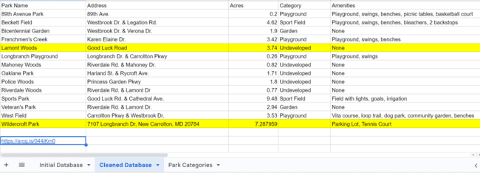
Database
https://docs.google.com/spreadsheets/d/1AZnOpIe0AifDT3P8PqoOWm7Sj3tG_Ofa86s1ZmGs8HA/edit?usp=sharing

Slide 10
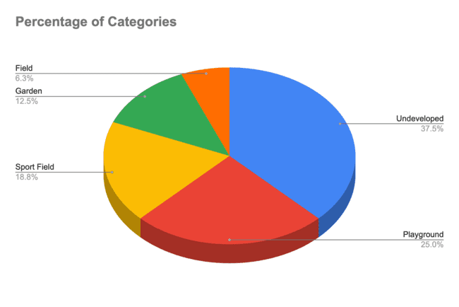
Visualizations
Notes:
Based on the information from the database, we can see that there are five main categories that are included in New Carrollton parks: fields, sports fields, gardens, playgrounds, and undeveloped areas. The areas that are undeveloped do not have any amenities in them. (ie: flood lights, trails, benches, etc.) Here we can see that a good majority, about 38% of parks are undeveloped, meaning that they don’t have the amenities needed to be useful for the community. This shows that there is an opportunity to improve these spaces and make them better for everyone.

Slide 11
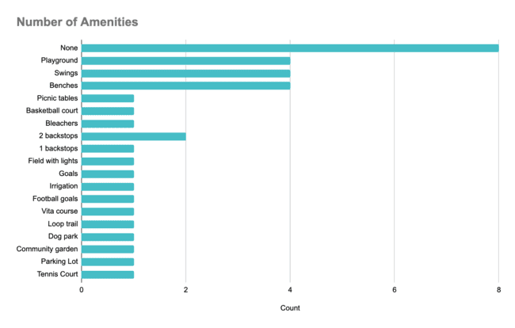
Visualizations
Notes:
Our second visualization lists of all the available amenities New Carrollton Parks have to offer and the amount of each of them. We can see that there are a large variety of amenities that range from tennis courts to picnic tables. However, similar to the previous image, this graph also suggests that there are a lack of amenities in 8 parks. This is important to note because it highlights the areas that could be improved to serve the community better and increase park usability in the future.

Slide 12
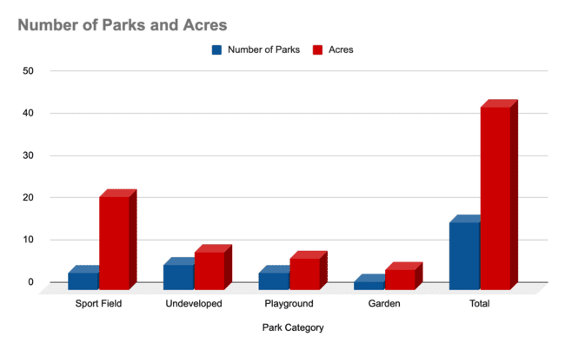
Visualizations
Notes:
Now this visualization is more interesting because it shows the number and sizes of the parks based on their corresponding categories. In the first column we can see that there are about four parks with dedicated sports fields, which tend to have more space. This makes sense, because sports fields require large open areas to accommodate activities and equipment. We can also see that there is a total of 16 parks with a combined 43 acres, so we currently have a lot of open green space in New Carrollton that is available for developments.

Slide 13
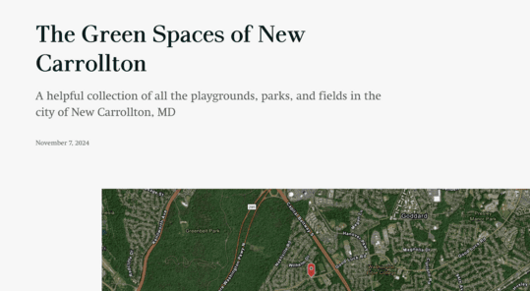
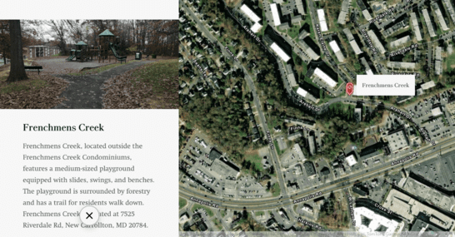
Story Maps
Notes:
Which deliverables should we focus on? Should we try and cover them all?

Slide 14
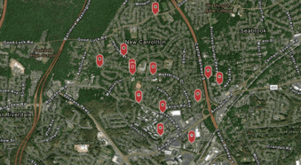
Story Maps

Slide 15
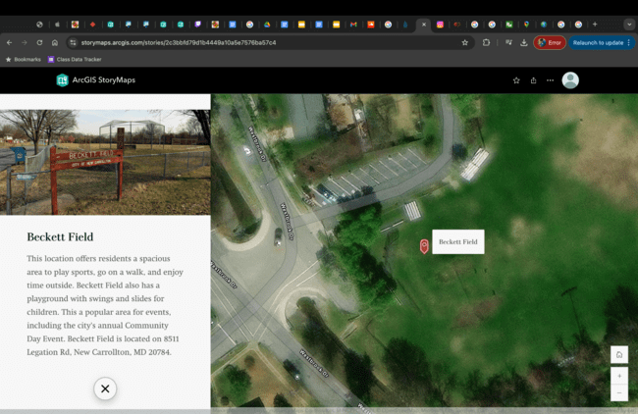
Story Maps

Slide 16
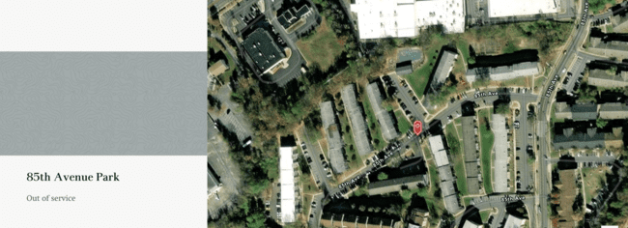
Story Maps

Slide 17
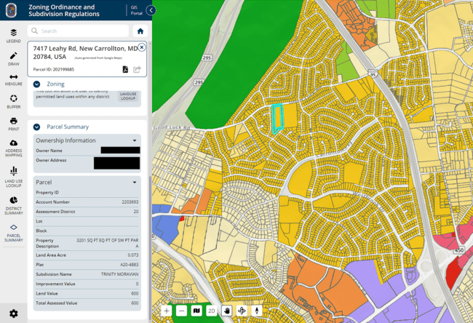
Park Ownership & Zoning Information
PGAtlas has a parcel layer, but no ownership info
Ownership status obtained from PGCCouncil’s zoning map
Park boundaries hand-drawn by referencing this map, Google Maps, and diagrams from the Master Plan
As part of the deliverable, I made a list of each park, its ownership status & address info
Example: zoning info for Lamont Woods

Slide 18
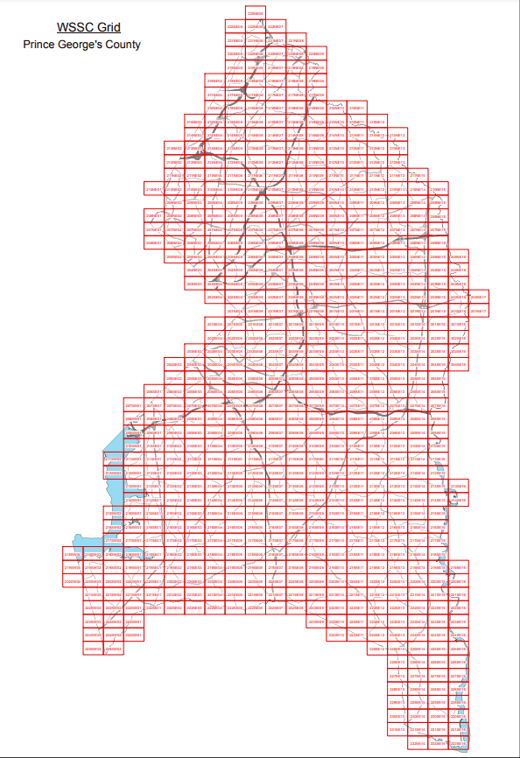
ArcGIS Data
Obtained contour data from PGPlanning’s GIS Open Data platform
Municipal boundary from PGC’s Open Data platform
Contour data split into seven sectors; combined in ArcGIS
Raw data included in deliverable

Slide 19
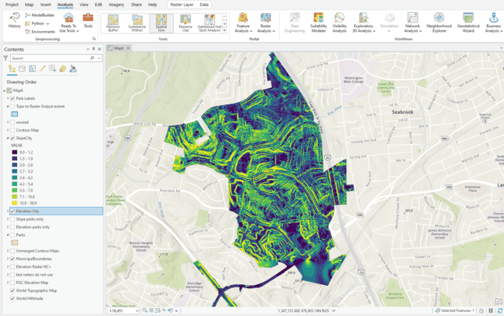
Contour Analysis
Rasterized contour data to obtain continuous elevation map, both of the entire city and just its green spaces
Derived slope maps from elevation data
Various other layers included in deliverable: mapped parks, obsolete rasters

Slide 20
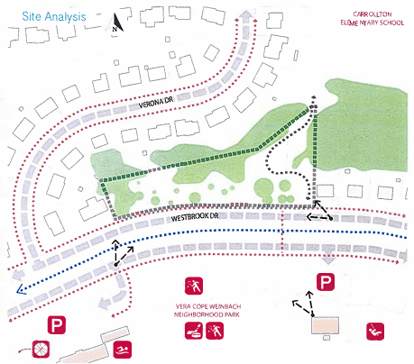
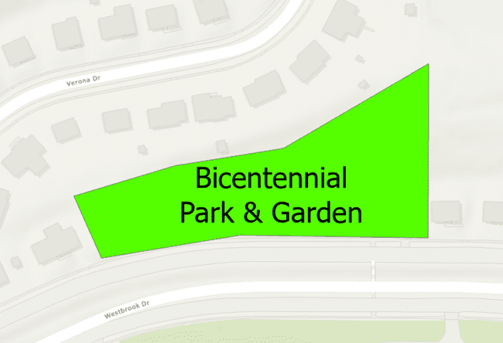
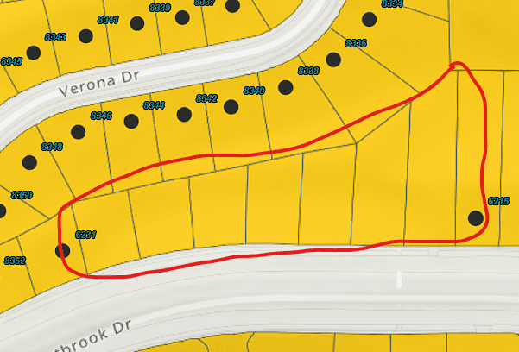
Recommendations for the Future
Rework the database to use the new GIS data
Search for any potential green spaces missed by the original Master Plan
Find a way to load zoning data directly into ArcGIS

Slide 21
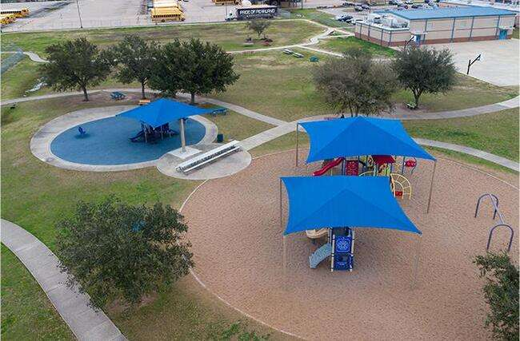
Recommendations for the Future Continued
Develop a website dedicated to New Carrollton parks for the public to use
Link the story maps to the website for easy accessibility
Create a submission box for amenities recommendations
Notes:
Based on the data we collected and the work we completed, we have a few recommendations for the City of New Carrollton. Due to communication and deadline limitations, we were unable to create a website to display this information for public use. However, we believe developing such a website in the future would be highly beneficial. Integrating our StoryMaps into this site would allow residents to easily locate parks based on their amenities. In addition to this, including a submission box for locals to request specific amenities would show that the city values community input and is committed to improving parks based on residents' needs and preferences.

Slide 22
Questions?

